Slide 1

Customer success
Monthly support report
Lazar Milicevic
Key metrics, achievements, roadmap & next steps
May 2025

Slide 2
Agenda
1
Part I: Abstra support key metrics
2
Part II: Achievements & roadmap
3
Part III: Roadmap items
deep dive
4
Part IV: Product Insights
5
Part V: Next steps

Slide 3
Executive Summary
Customer success: Monthly Support Report - May 2025
Metrics summary:
113 tickets handled in May (−35% vs April), showing reduced volume due to improved system stability and automation.
First response time averaged 24 minutes, slightly higher than April due to K-Signup prioritization and three public holidays — but still far below the 2-hour SLA threshold.
Average resolution time dropped to 2.2 hours, marking an 80% improvement, driven by better ticket flows and faster triage.
CSAT remained high at 92.3%, confirming strong user satisfaction despite the operational scale-up.
Blocking issues remained stable (10 total), with all resolved within SLA
Zendesk & Process Improvements
Daily signup report automation script (pagination, Excel, UTC support).
3-strike rule and better classification logic improved backlog handling.
SurveySparrow logic finalized for 2nd-login display; frontend integration underway.
Defined and scoped logic for conditional SurveySparrow display (on second login), with frontend implementation in progress.
Improved agent workflows by aligning Zendesk views and macros with current ticket types and support responsibilities.
TL;DR - Most important points in one place!
Owkin K
Owkin K Support handled 593 tickets in May, becoming the most active squad by far — primarily driven by the K-Navigator launch and related signup access flows.
Fully operational Zendesk Help Center continued to guide users, with automated welcome messages helping streamline onboarding.
Dedicated FullStory dashboards were enhanced with filters, enabling better behavioral insights and segmentation.
Learnings from May are now informing improvements to early detection, approval automation, and onboarding UX for Owkin K users.

Slide 4

Agenda
1
Part I: Abstra support key metrics
2
Part II: Achievements & roadmap
3
Part III: Roadmap items
deep dive
4
Part IV: Product Insights
5
Part V: Next steps

Slide 5
Abstra at a glance - Fullstory Metrics
Customer success: Monthly Support Report - May 2025
A general overview of numerical metrics and feature adoption compared with previous month
General Metrics
Catalog Metrics
Slide Viewer Metrics
Other Metrics
Active Users
144
-17.7%
Dataset Search
643
-25.7%
Users
45
-4.3%
Target Directory Users
11
-26.7%
New Users
48
0%
Dataset Views
2553
-8.2%
Sessions
386
-7.4%
Average session
per user
22
-4.3%
Abstra
Documentation
26
+13%

Slide 6
Key metrics overview
Customer success: Monthly Support Report - May 2025
General monthly key metrics
May was a month of consolidation and process optimization, marked by enhanced automation, improved internal workflows, and the rollout of structured Zendesk forms for recurring request types. These changes contributed to greater operational stability and more consistent handling of incoming tickets.
✅ 113 tickets handled a −35.06% drop from April, reflecting improved system stability, ongoing automation efforts, and the introduction of new Zendesk forms for specific request types.
⚙️ 24 min first response time – a +41.18% increase, primarily due to a high volume of K-Signup requests that were prioritized, combined with three public holidays during May.
Despite this, response time remained consistently under 25 minutes, staying well below the 2-hour SLA threshold.
⏱️ 2.2 hrs average resolution time – a −80% improvement compared to April, driven by better classification logic, improved triage, and reduced complexity in internal workflows.
🌟 92.3% CSAT – a slight dip (−4.56%) from April, but overall satisfaction remained high, reflecting trust in the support team and process efficiency.
📈 99.12% tickets resolved – up +14.18%, enabled by refined workflows, automated reporting, and full processing of categorized ticket flows.
April
May
Change
Tickets Received
174
113
−35.06%
Solved/Received
86.78%
99.12%
+14.18%
Average First Response Time (Bus. hrs.)
17 min
24 min
+41.18%
Average Full Resolution Time (Bus. hrs.)
11 hrs
2.2 hrs
−80.00%
% Satisfied CSAT
96.7%
92.3%
−4.56%
*Times are in business hours.
Key Observations:
✔️ Stabilization in overall ticket volume, driven by improved automation and structured Zendesk forms.
✔️ Prioritization of K-Signup requests contributed to longer FRT, but SLA remained fully respected.
✔️ Enhanced internal efficiency through automated reporting, clearer classification logic, and consistent L2 ticket rotation.

Slide 7
Monthly Ticket Counts & Average Resolution Times
Customer success: Monthly Support Report - May 2025
Compared with previous 3 months
2025
Tickets Received
Avg. Full Resolution Time
February
206
6.7 hrs
March
254
3.9 hrs
April
174
11 hrs
May
113
2.2 hrs
*Times are in business hours.
May Summary
✔️ 113 tickets handled – down 35.06%, showing system stability and automation impact.
✔️ 24 min FRT – slightly up due to K-Signup volume and 3 holidays, but still far below 2h SLA.
✔️ 2.2 hrs avg. resolution – improved by 80%, thanks to better triage and simpler flows.
✔️ 92.3% CSAT – small dip, but satisfaction remains strong.
We remain focused on quality and responsiveness as internal demand scales.

Slide 8
Blocking issues key metrics overview
Customer success: Monthly Support Report - May 2025
Monthly metrics and changes for the reported blocking issues
April
May
Change
Blocking issue volume remained stable in May, with 10 reported cases, identical to April.
While resolution performance decreased compared to the previous month, response and resolution times stayed well within SLA thresholds, ensuring continued reliability for critical support.
✔️ First response time averaged 12 minutes (0.2 hrs) – slightly higher than April, but still ensuring fast initial engagement for urgent issues.
🕒 Average resolution time was 10.6 hrs – a notable increase, but still under the 24h SLA limit, despite several complex cases requiring extended coordination.
We're actively working on early detection of complex/blocking tickets, and learnings from May will be used to speed up handling and resolution in the coming months.
Tickets Received
10
10
0%
Solved
9
6
−33.33%
Average First Response Time (Bus. hrs.)
0.1 hrs
0.2 hrs
+100%
Average Full Resolution Time (Bus. hrs.)
1.7 hrs
10.6 hrs
+523.53%
*Times are in business hours.

Slide 9
Number of tickets received per topic
Customer success: Monthly Support Report - May 2025
Increasing tickets related to Dataset Creation as well as SageMaker issues.
May showed a continued demand across recurring technical topics, with SageMaker and project onboarding remaining among the most common themes.
📌 The most notable trends this month include:
✔️ 7 tickets related to SageMaker issues, indicating sustained usage and support needs.
✔️ 5 tickets requesting creation of new Abstra Projects, showing steady onboarding activity.
✔️ 3 tickets requesting to be added to user groups, reflecting ongoing access management tasks.
✔️ 2 tickets categorized as "Other", including internal tool requests.
❌ 0 tickets for enabling CI access to CodeArtifact, a drop from April.
Topic
Tickets
Other
2
SageMaker Issues
7
Create a new Abstra Project
5
Request to be added to user group
3
Allowing CI to access codeartifact package registry
0
Notes:
rank by desc order

Slide 10
Trend in topics received compared with previous month
Customer success: Monthly Support Report - May 2025
Highest changes in number of tickets received per topic
April
May
Change
May ticket trends showed a drop in volume across most recurring topics, while dataset onboarding activity increased.
● "Other" category saw a significant drop (−88.24%), likely due to better classification and form routing.
● SageMaker Issues decreased by 53.33%, though it remains a key area for ongoing support.
● Requests for new Abstra Projects dropped 44.44%, stabilizing after onboarding spikes in previous months.
● Dataset Creation Approval requests grew by +200%, suggesting renewed data onboarding activity.
● CI access to CodeArtifact dropped to zero (−100%), indicating that earlier automation efforts are now effective.
Other
17
2
−88.24%
SageMaker Issues
15
7
−53.33%
Create a new Abstra Project
9
5
−44.44%
Dataset::Dataset Creation Approval Request
1
3
+200.00%
Allowing CI to access codeartifact package registry
6
0
−100.00%

Slide 11
Tickets per squad
Customer success: Monthly Support Report - May 2025
Month-over-Month (MoM) Overview for ticket counts per squad
Owkin K Support saw a major spike with 593 tickets, becoming the most active squad. The increase was driven by the K-Navigator launch and high volume of signup requests processed during May.
The Research Platform squad handled 80 tickets, maintaining strong involvement with internal tooling, experimentation, and advanced user workflows.
Infrastructure Platform remained steady with 22 tickets, continuing its key role in AWS access and internal configuration support.
L1 Support processed 16 tickets, assisting with initial triage and user setup, especially for new users.
The Data Infrastructure squad managed 10 tickets,
Data Content, Biopharma Product, Solution Architecture, handled a small number of tickets each, indicating specialized or early-stage engagements.

Slide 12
Help Center article views - April 2025
Customer success: Monthly Support Report - May 2025
Most viewed help center articles in the month
Top articles viewed this month:
Owkin K - Brand
Abstra - Brand
Article
Views
Article
Views
Owkin K User Guide: Getting started
253
Abstra access requests
4
Owkin K User Guide: Available plots
46
Dataset creation approval request
2
Owkin K User Guide – Available data
79
How to access Owkin's Github
1
What are the previous versions of Owkin K Navigator Terms & Conditions?
15
How to effectively report an issue and get quick support
1

Slide 13


🏆
Superstar of the month!
Part title
Guilhem Barthés
Handling most number of L2 tickets
Jorge Arellano Castro
For having the least first response time of 0.01
business hours

Slide 14

Agenda
1
Part I: Abstra support key metrics
2
Part II: Achievements & roadmap
3
Part III: Roadmap items
deep dive
4
Part IV: Product Insights
5
Part V: Next steps

Slide 15
Customer success roadmap timeline
Customer success: Monthly Support Report - May 2025
Main topics we aim to achieve through Q2-25.
April
May
June
Handling more l2 tickets
Zendesk – Focal point for all requests
Owkin K – Making support infrastructure better based on early insights
Implementing Zendesk 3 strike rule
Handle more L2 tickets and fully take over tickets related to Owkin K, with the help of developers.
Bringing support to a new level, continuously maintaining a first response rate below 20 minutes.
Prioritize Owkin K support during the launch.
Maintain the first response time for both Abstra-related and Owkin K tickets under 20 minutes.
Owkin K – Continuous process improvement, support infrastructure based on feedback and work.
Extend FullStory dashboards to track user role-based behaviors and P0 metrics.
Finalize SurveySparrow logic integration on 2nd login with frontend implementation.
Maintain <20 min first response time for all K-Navigator tickets with continued L1/L2 triage efficiency.
Develop automated approval system for K-Signup requests, reducing manual workload and improving onboarding speed.
May Highlights:
Fully processed all K-Signup tickets, improved classification logic, and reduced Zendesk queue via 3-strike rule.
Automated daily signup reporting with advanced Python script (pagination, Excel export, UTC support).
Maintained <25 min FRT with active L1/L2 rotation and Cognito-based access handling.
Laying the foundation for June: better follow-ups, smarter workflows, and scalable support.

Slide 16
Agenda
1
Part I: Abstra support key metrics
2
Part II: Achievements & roadmap
3
Part III: Roadmap items
deep dive
4
Part IV: Product Insights
5
Part V: Next steps

Slide 17
Customer success Q2 Roadmap items (RIs)
Customer success: Monthly Support Report - May 2025
01
Zendesk – Focal point for all support requests
02
Leverage FullStory insights to improve Owkin K support infrastructure
03
Maintain first response time under 20 minutes for both Abstra-related and Owkin K tickets

Slide 18
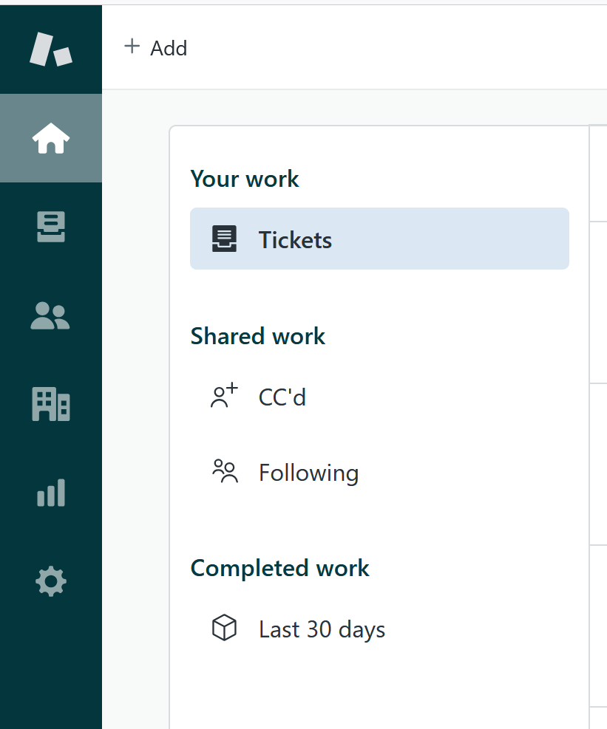
RI#1: Zendesk – Focal point for all support requests
Customer success: Monthly Support Report - May 2025
🛠️ RI#1 Zendesk – Establishing a Unified Entry Point for Support
As Owkin continues to scale, it's essential to align support infrastructure with organizational growth. In May , we plan to finalize the consolidation of all incoming support requests into Zendesk as the primary entry point, reducing fragmentation across Slack, email, and ad-hoc channels.
This effort aims to create a single source of truth for all support interactions, enabling faster response times, clearer ownership, and more consistent reporting.
✅ Key Improvements Implemented in April/May:
🔧 Ticket Visibility Enhancement
• Created a dedicated view for tickets tagged with k-signup-request
• Resolved visibility gaps for API-submitted onboarding tickets
🔧 Welcome Message Automation
• Implemented branded welcome messages for Abstra and Owkin K
• Personalized replies direct Owkin K users to the Help Center
• Messages are instant but do not impact FRT SLA — preserving reporting integrity
🌟 Why This Matters
These changes significantly improve first-touch user experience, reduce confusion, and foster a sense of proactive and structured support, especially as ticket volumes increase.
This foundation sets the stage for future expansion and ensures Zendesk can scale with Owkin's evolving support needs.

Slide 19
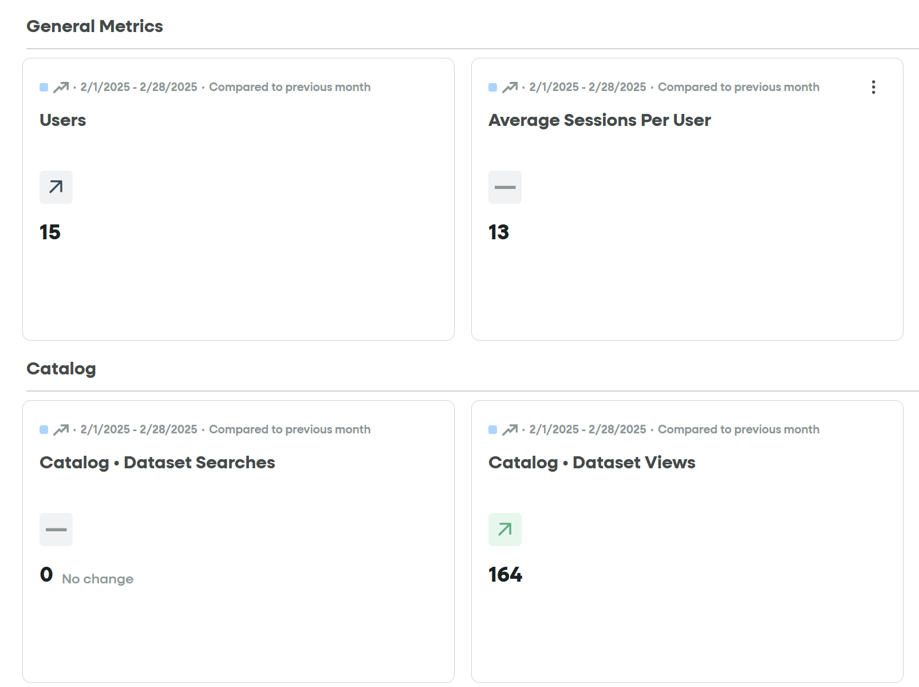
RI#2 Leverage Fullstory insights
Customer success: Monthly Support Report - May 2025
🚀 RI#2 Leverage FullStory Insights
Targeted Visibility into Owkin K User Behavior
During April, we resolved the key issue of inaccurate metrics caused by Owkin K being tracked together with Abstra under the same FullStory account.
Thanks to strong collaboration with the frontend team and several syncs with our FullStory account manager, custom user attributes were implemented. These now allow us to distinctly identify Owkin K users and track them separately.
✅ As a result, we now have a dedicated FullStory dashboard exclusively focused on Owkin K user activity
✅ Improved clarity in behavioral analytics and onboarding monitoring
✅ Clearer ownership of platform-specific insights
📊 Room for Improvement:
Further enhancements are being considered — including tracking in-app user feedback (e.g. thumbs up/down), to better capture qualitative sentiment and platform usability in real time.
Fullstory – Owkin K

Slide 20
Agenda
1
Part I: Abstra support key metrics
2
Part II: Achievements & roadmap
3
Part III: Roadmap items
deep dive
4
Part IV: Product Insights
5
Part V: Next steps

Slide 21
Next steps for Customer Success
Customer success: Monthly Support Report - May 2025
Deliver excellent customer service
→ Maintain <20 min first response time for K-Navigator tickets with L1/L2 triage rotation.
→ Resolve remaining signup access issues and automate approval flow via Cognito.
→ Continue supporting internal users across Slack/Zendesk with real-time troubleshooting.
Improving Zendesk Process Efficiency
→ Monitor impact of the automated 3-strike rule and signup classification improvements.
→ Implement logic-based automated K-Signup approvals to reduce manual work and boost user onboarding volume, enabling faster access, more feedback, and improved usage metrics.
→ Refine ticket routing and triggers for high-volume requests.
Please do not hesitate to reach out to me for any questions.
Deepen Insights from FullStory Analytics → Use custom attributes to track user behavior by role/stage and separate environments.
→ Review P0 funnel metrics and refine dashboards with frontend team.
→ Finalize logic for conditional SurveySparrow display on second login.

Slide 22
Agenda
1
Part I: Abstra support key metrics
2
Part II: Achievements & roadmap
3
Part III: Roadmap items
deep dive
4
Part IV: Product Insights
5
Part V: Next steps

Slide 23
Thank you!

